Slide 1
Client Team Number: 18 Development Team Number: 14
Strangely
SYNC WELL WITH STRANGERS​
Development Team
Rachit Khanna
Mohd Faizan
Nizamul Kazi
Freya Jayant Vora
Nisarg Chudasama
CSCI5308 - Adv Topics in Software Develop

Slide 2
Summary
STRANGELY: SYNC WELL WITH STRANGERS​
STRANGELY pioneers a new approach to local networking by uniting residents through diverse activities. It bridges the gap between newcomers and locals, simplifying daily tasks while fostering community bonds.
Unique in its focus, STRANGELY stands apart from platforms centered on established connections or dating. It fills the void by aiding newcomers in settling and connecting based on shared activities.
Initial features like Community Cooking, Daily Life Travel, Outdoor Excursions, and Sports Club match-ups lay the foundation. Future plans include expanding activity options and enhancing user engagement through interactive features.

Slide 3
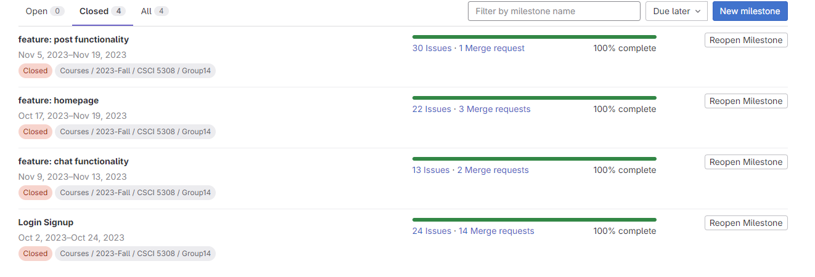
Project Dashboard Statistics
Total number of tasks

Slide 4
Tasks completed by each individual
Total number of story points: 40
Login Feature: 6 points
Rachit: 2
Freya: 1
Faizan: 1
Nisarg: 0.5
Kazi: 1.5
Homepage - 11 points
Rachit: 2
Freya: 3
Faizan: 1
Nisarg: 3
Kazi: 2
Chat Feature: 9 points
Rachit: 1
Freya: 1
Faizan: 1
Nisarg: 3
Kazi: 3
Post Feature: 14 points
Rachit: 3
Freya: 3
Faizan: 4
Nisarg: 2
Kazi: 2

Slide 5
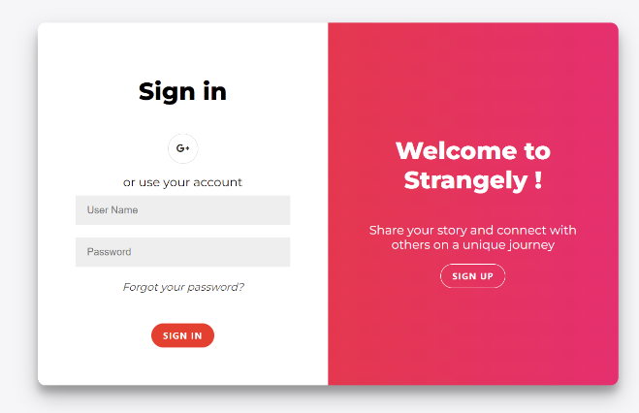
Application Demo
Users can register themselves on the signup page using their own email or can register with their google account.

Slide 6
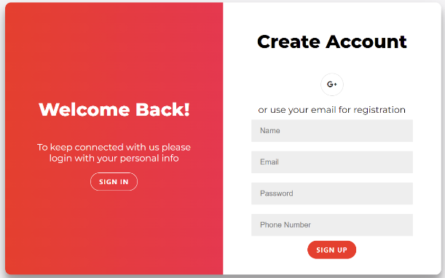
Same users can login using those credentials or can login with google account after registering.

Slide 7
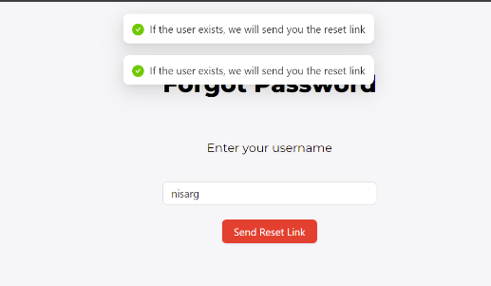
Forgot password functionality

Slide 8
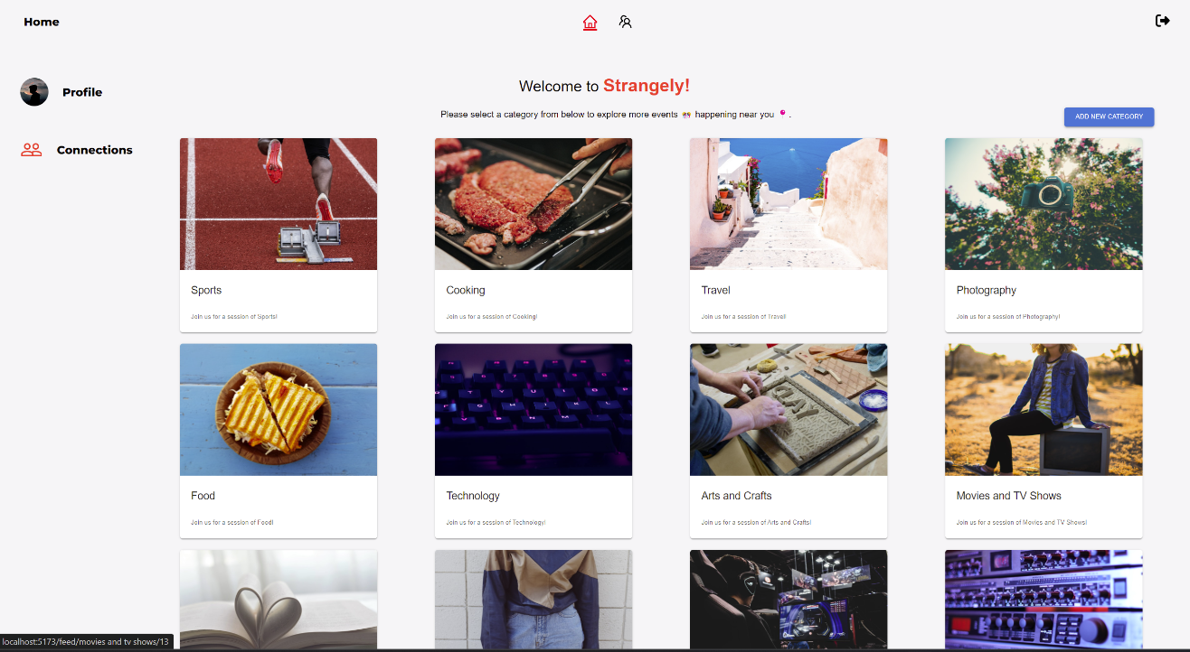
Homepage

Slide 9
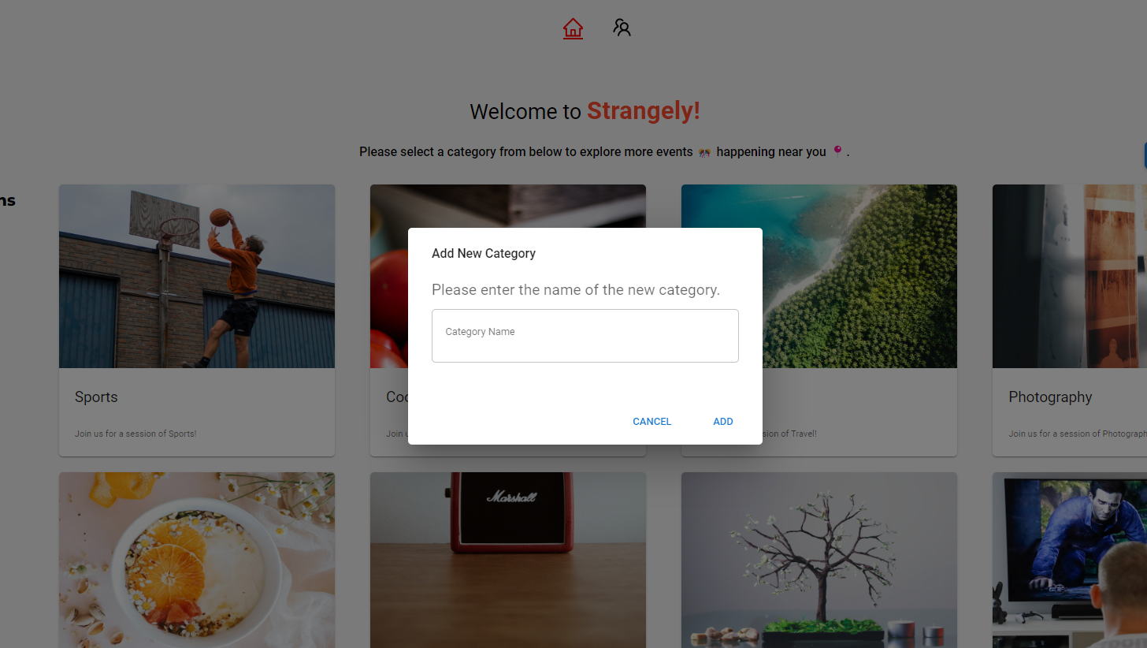
Add new category

Slide 10
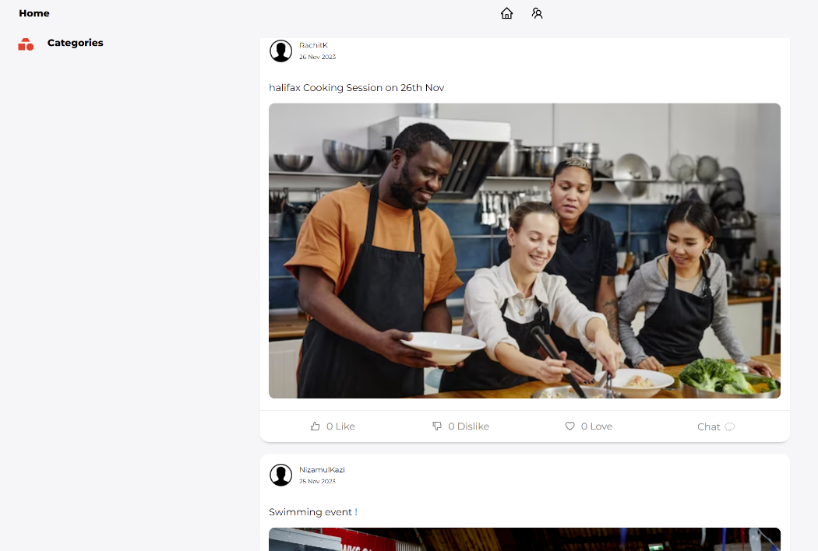
User Feed

Slide 11
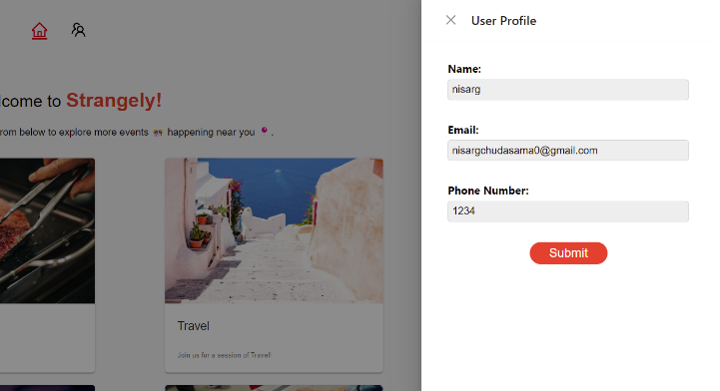
User profile settings

Slide 12
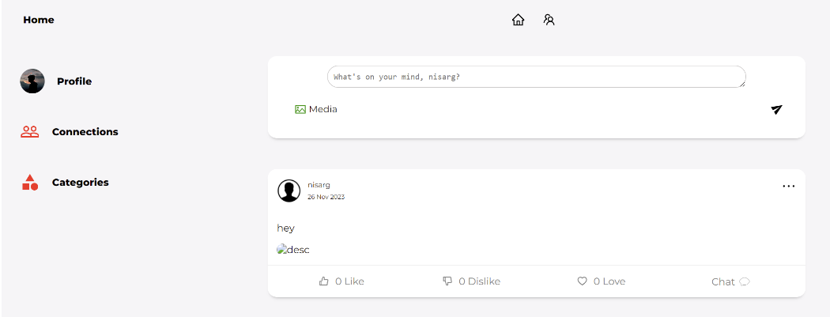
Add Post

Slide 13
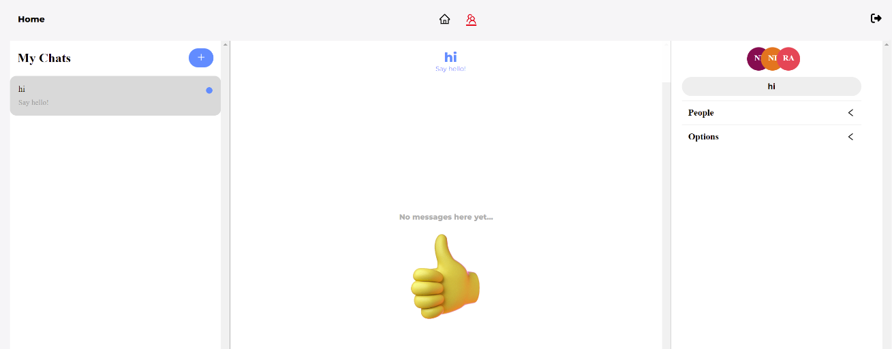
Connections and previous chat history

Slide 14
Project status
Goals | Status
Login Signup | Completed
Chat functionality | Completed
Post functionality | Completed
Homepage | Completed

Slide 15
Learning from the project
Technical Learnings:
Java & Code Quality
Test-Driven Development (TDD)
CI/CD & Deployment Efficiency
Refined Deployment Practices
Continuous Improvement Culture
People Skills:
Collaboration and Teamwork
Adaptability and Flexibility
Conflict Resolution
Time Management
Empathy and Understanding
Open-Mindedness

Slide 16
What’s next ?
Feature Expansion: Exploring additional activities or refining existing ones based on user behavior.
Mobile Optimization: Developing a dedicated mobile app.
Comments: Users can add comments as a review to the post
Data Analytics for Personalization: Delve deeper into user behavior and preference to personalize the user experience and improve engagement.
More methods of authentication: login with OTP, Facebook, Microsoft authenticator

Slide 17
Demo Video

